Slide 1


Academy
Docker 101
Anthony McKale
Principal Software Engineer

Slide 2
Agenda
- History
- Virtual Machines
- Containerisation
- Docker
- Docker Registries
- Multi-Container

Slide 3
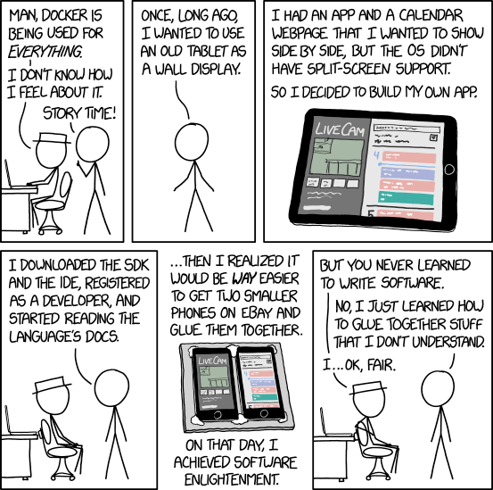
Containerisation is replacing coding…
The Heart of Containerisation is GLUE
https://xkcd.com/1988/

Slide 4
History
Green Threading (Time Sharing) – the 1960’s VM… aka running several programs
Chroot Jails popular in the 70s https://en.wikipedia.org/wiki/Chroot
Virtual Machines 2000’s Virtual machines popularised on x86 platform
Container popularity: Docker 2010’s docker emerges as the dominant Image format aka the Chroot Jail 2.0

Slide 5
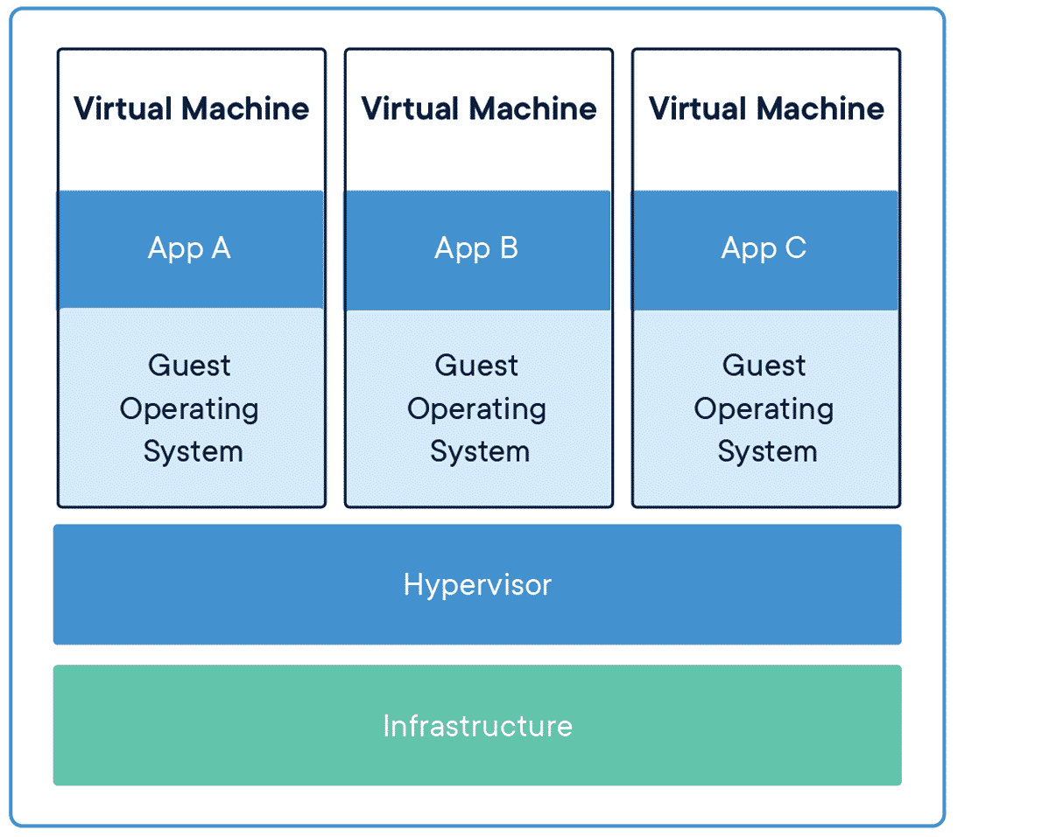
Virtual Machines

Slide 6
Virtual Machines
A Virtual Machine is an emulated computer system, and come in two common flavours: Process virtual machines: Simple abstracted process running instructions, runnable anywhere the VM Engine is available aka Java has a portable VM, implemented on many OSs System virtual machines: Fully emulated computer, running Operating System Image

Slide 7
Virtual Machines: parts
Engine: Software for running the Image
Image: byte code instructions or OS to run
Hypervisor: hardware to efficiently managed multiple Oss often turned off by default*, missing on budget computers

Slide 8
Virtual Machines: hypervisor why?
Raw emulated code is slow, like 50-90% slower than native code
Hypervisor specialist hardware device to speed up hosted Virtual Machines
Docker on windows* uses hyper-V type 1 to speed up things
* Docker Linux non-hypervisor
https://www.docker.com/resources/what-container/

Slide 9
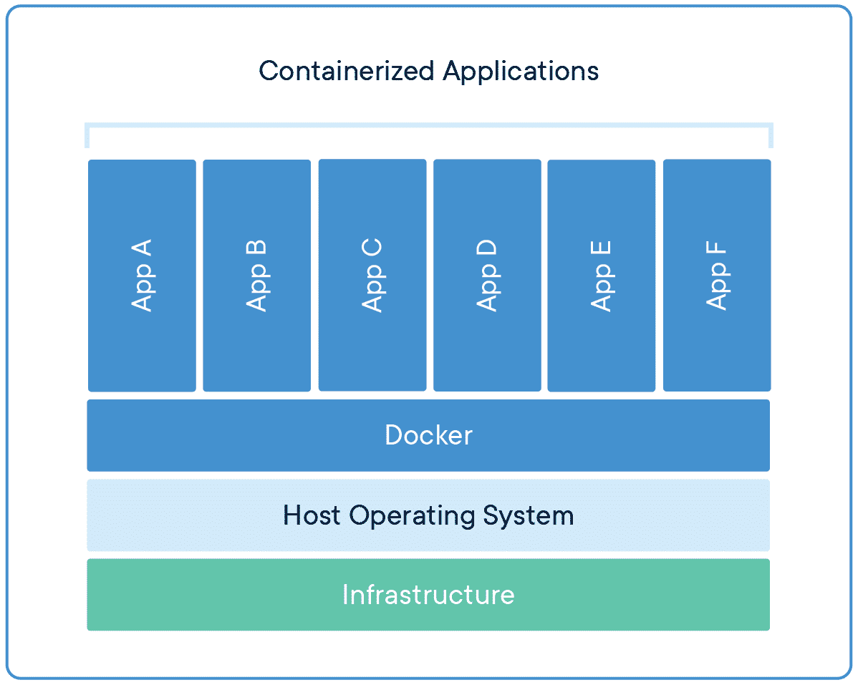
Containers

Slide 10
Container
A container is an partial OS / Application running on a hosted OS
Containers are isolated on the computer, using OS process isolation features
For Linux this is typically a service called containerd under the bonnet
https://containerd.io/

Slide 11
Container: parts
Host OS: Typically Linux OS
Container Engine: Software for running the Image
Container Image: Application to run

Slide 12
Virtual Machines: pros and cons
PROS:
Portable: Images Completely portable
CONS:
Speed: emulated code is slow even with hypervisors
Bootup: OS needs booted up, taking mins

Slide 13
Containers : pros and cons
PROS:
Bootup: container only needs copied, taking secs
Speed: Code runs at native speed
CONS:
Portable: Images portable to supported OS * for docker linux, with VMs used for Windows / Mac support

Slide 14
Docker =vs= Docker Desktop
Docker runs the native Linux with it’s container service, providing an easy to use CLI
Docker Desktop, runs a Linux VM, which then runs Docker
Docker Desktop allows the docker cli and linux containers, to be ran in non-linux environments
At a cost….

Slide 15
Containers: docker windows/linux
Raw emulated code is slow, like 50-90% slower than native code, Docker uses containers to speed up Linux
Linux Docker uses native Containers
Windows Docker runs Linux VM running Linux Docker
Docker Linux is much faster than Docker Windows
https://www.docker.com/resources/what-container/ https://www.redhat.com/en/topics/containers/whats-a-linux-container https://en.wikipedia.org/wiki/Containerization_(computing)

Slide 16
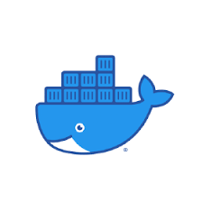
Docker

Slide 17
Docker
Docker the defacto Containersation platform
Defacto system used by most Cloud Platforms / Opensource projects
Containerisation is packaging applications in an image to make them portable (and sharing some Linux resources)
Dockerhub is a registry of pre-packaged docker images

Slide 18
Docker
Docker parts: CLI: Software for running the Image
Docker Image: OS + application to run
Dockerfile: Engine Instructions howto create a docker image

Slide 19

Docker CLI Commands
BUILD run a fresh image from a Dockerfile https://dockerlabs.collabnix.com/docker/cheatsheet/

Slide 20
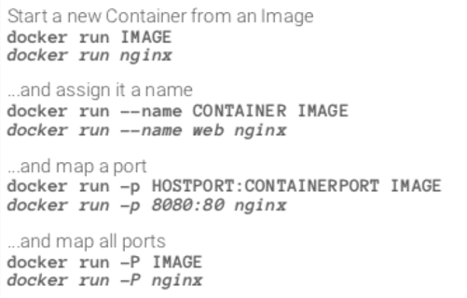
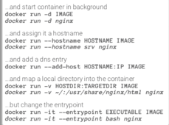
Docker CLI Commands: RUN
RUN running a built/or remote image * -it = for taking user input
https://dockerlabs.collabnix.com/docker/cheatsheet/

Slide 21
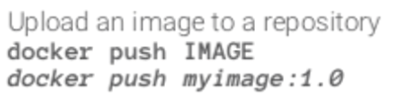
Docker CLI Commands
PUSH sending images to dockerhub*
https://dockerlabs.collabnix.com/docker/cheatsheet/

Slide 22

Docker CLI Commands DEBUGGING
DEBUGGING EXEC debugging image with a bash shell inside running container https://dockerlabs.collabnix.com/docker/cheatsheet/ docker run -name SOMETHING image_name docker ps docker exec -it SOMETHING bash

Slide 23
Docker CLI Commands DEBUGGING
STOPPING RUNAWAY IMAGES stopping running images https://dockerlabs.collabnix.com/docker/cheatsheet/ # WHEN docker run -name SOMETHING image_name # FIND IMAGE docker ps # STOP AND REMOVE IMAGE docker stop SOMETHING docker rm SEOMTHING

Slide 24
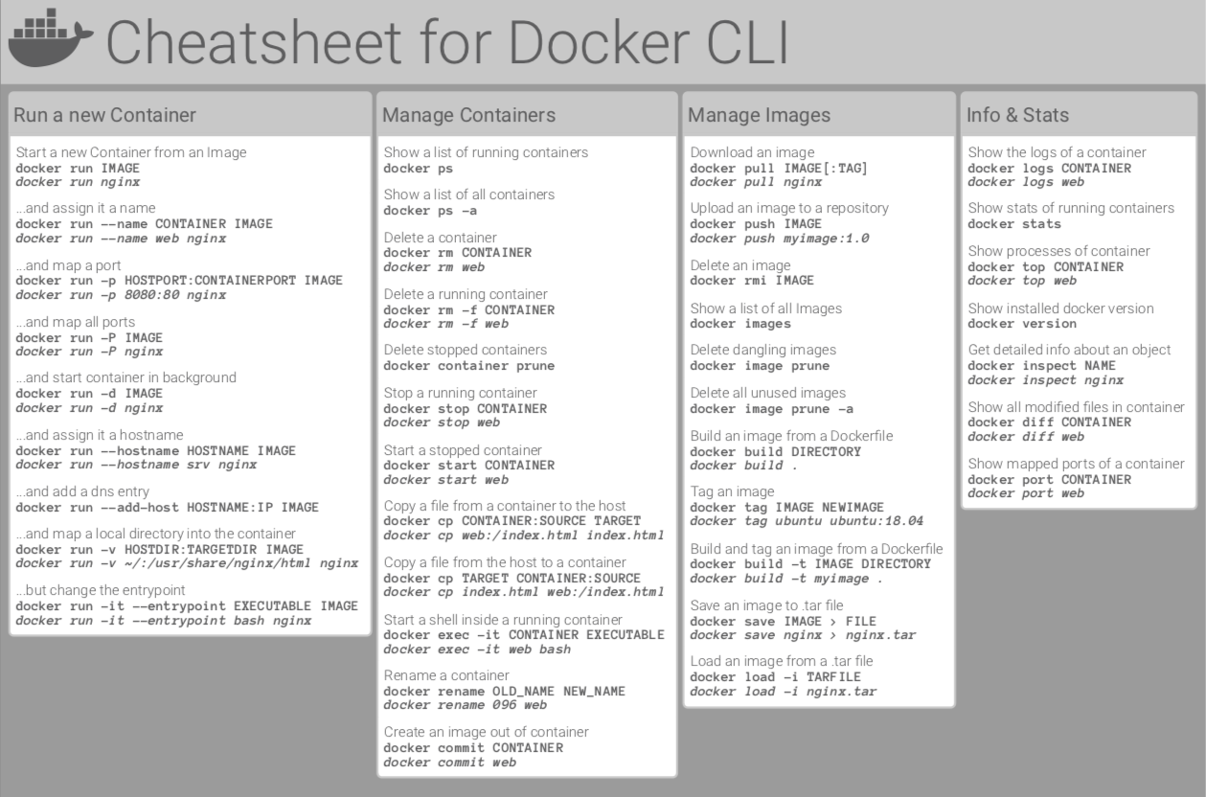
Docker CLI Commands
https://dockerlabs.collabnix.com/docker/cheatsheet/ collabnix cheatsheet

Slide 25
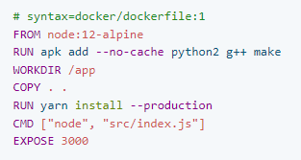
Dockerfile
Dockerfile is the recipe for an image
Typical Structure:
FROM – Base aka linux with node COPY - Copy node code RUN - Install any dependencies
CMD - Container start command
https://docs.docker.com/engine/reference/builder/ https://docs.docker.com/develop/develop-images/dockerfile_best-practices/

Slide 26
Dockerfile
Easy to use build with docker cli $ docker build <Dockerfile> -t <image tag>
https://docs.docker.com/engine/reference/builder/ https://docs.docker.com/develop/develop-images/dockerfile_best-practices/

Slide 27
Dockerhub
Dockerhub is a registry of created Docker images
When you run a Docker image, if not locally stored will be got from Dockerhub aka $ docker run riversafe/eze-cli --version https://hub.docker.com/

Slide 28
winpty
Dockerhub is not alone
Dockerhub is Docker’s Image Registry
ECR is AWS’s Image Registry
ACR is Microsoft’s Image Registry
….
Docker CLI can be configured to use all of them ☺

Slide 29
Multi Container
-

Slide 30
Multi Container: Docker Compose
Docker compose is:
running several docker images
talking together one a single computer
start/stop management of cluster of images
https://docs.docker.com/compose/

Slide 31
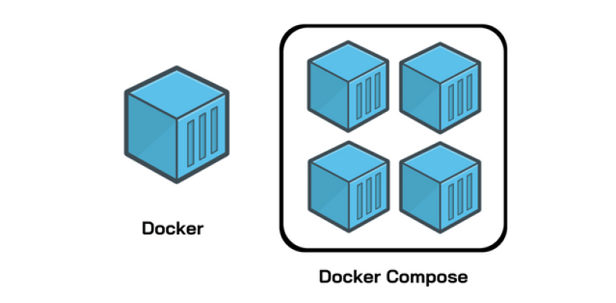
Multi Container: Docker Compose
https://docs.docker.com/compose/ https://blog.knoldus.com/how-to-run-multi-container-applications-with-docker-compose/

Slide 32
Multi Container: Kubernetes
Kubernetes is:
running several docker images
running those images across several computers
running multiple copies of those images on demand / auto scaling
talking together via network
start/stop management of cluster of images
https://kubernetes.io/

Slide 33
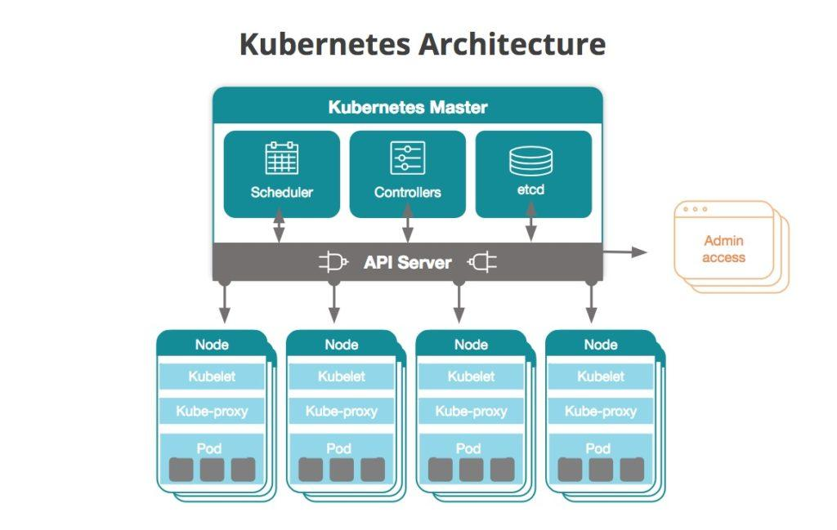
Multi Container: Kubernetes
https://kubernetes.io/ https://newrelic.com/blog/how-to-relic/what-is-kubernetes

Slide 34
Windows Local Setup - install docker - make sure hypervisor enabled - setup wsl (for linux VM for docker) - restart - verify working ` $ docker run hello-world `
https://docs.docker.com/get-started/docker_cheatsheet.pdf

Slide 35
Questions
I’ve been Anthony “Zapper” M^{c}Kale
Hopefully I’ve Educated, Informed, and even Entertained Good Testing is Good Security is Good software

Slide 36
Thank you

